Slide 1
Battleship Game
Danny Jarquin
Notes:
Hello my name is Danny and I will be going over my take on the battleship game using unity as my development platform.

Slide 2
Introduction
The project emphasizes the development of the game battleship. It is a game that has been around since World War I. The main concept for the game revolves around two players taking turns to try and sink each other’s naval ships. Each player is given five ships and a 10x10 grid board for players to set their ships. The ships have various sizes which may take more than two squares up to five on the grid. There have been various iterations of the game and this one is developed through Unity’s game engine, and it’s meant to be a single player experience against an ai player.

Slide 3
Design Approach
The goals for the game were to take the concepts of the battleship game with the imposed requirements for the project while giving it our own personal touch when it came to the design of assets and overall aesthetics for the game.
Users – Create a simple interface for users to navigate and interact with using the mouse and keyboard.
Developer – Create code that is easy to understand and follow. Apply proper methodology of functions, methods associated with the classes used for development of the game. Proper comments for each class, methods to portray clarity of its function and complexity.
A simple approach was taken to ensure the reduction of making the implemented tasks less complex by avoiding advanced techniques or structures for the project.

Slide 4

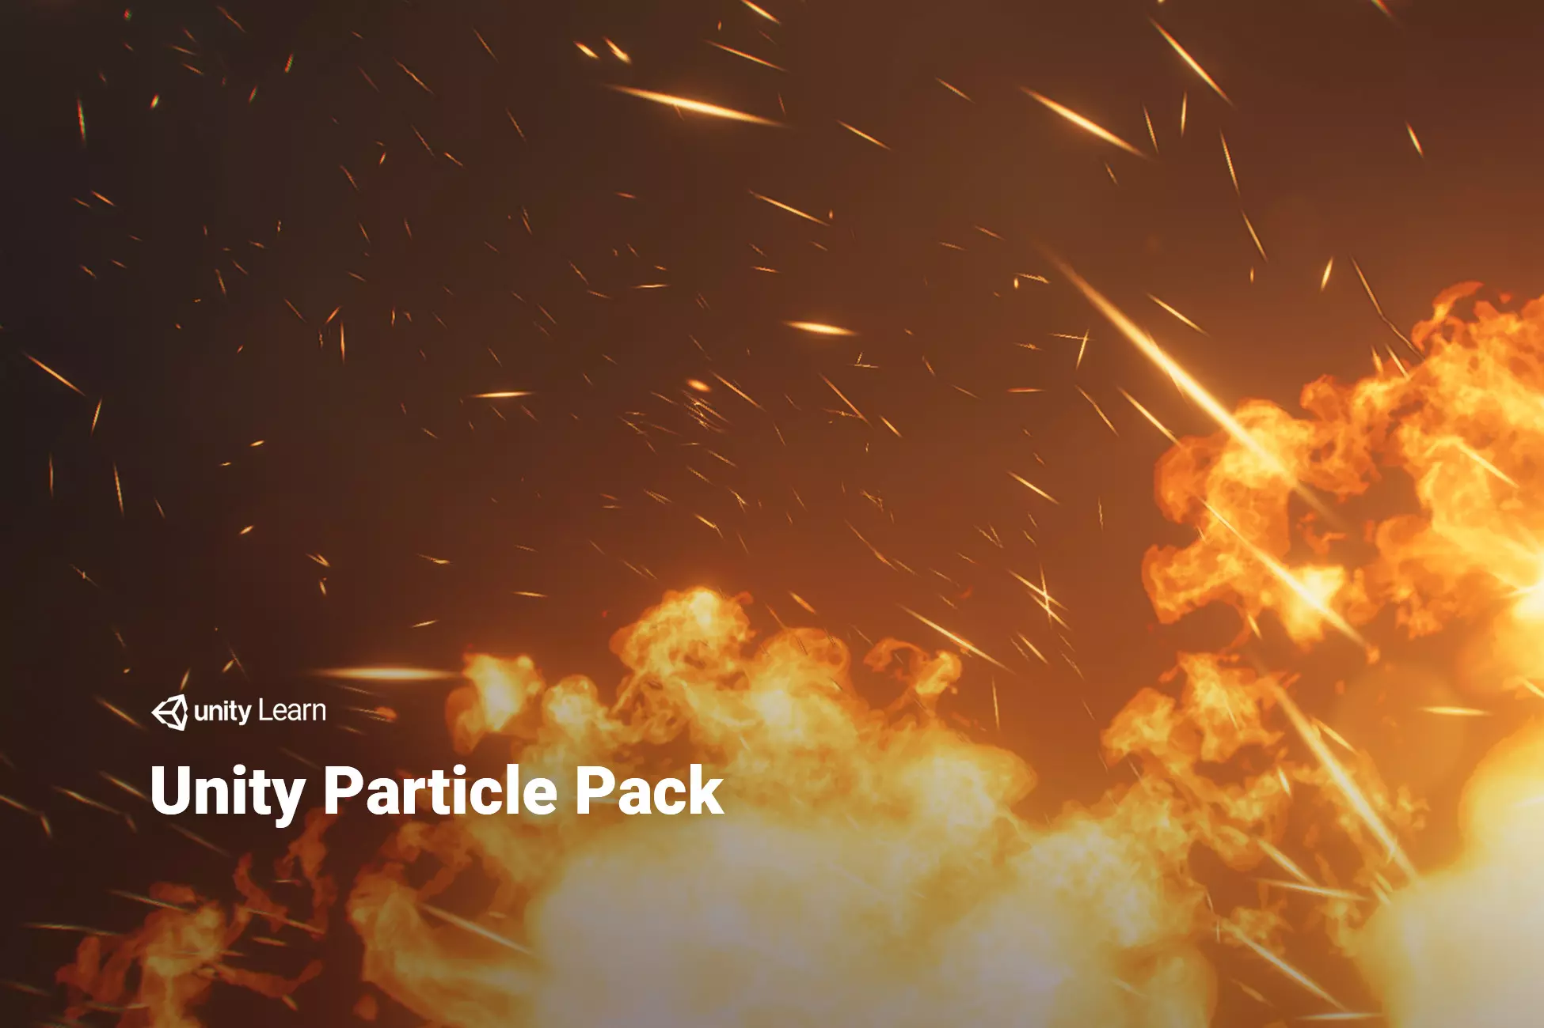
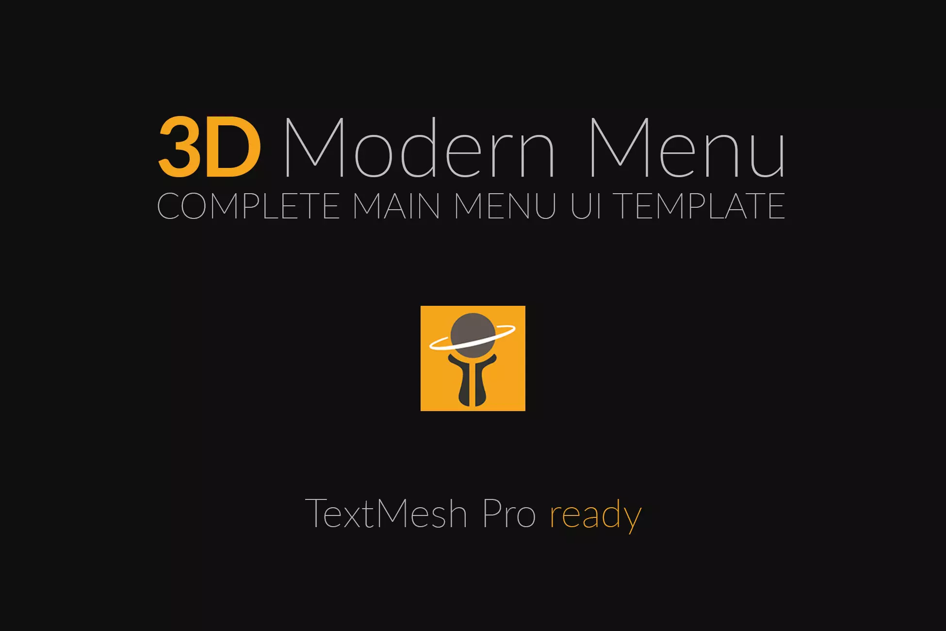
Assets Used
Unity Particle pack –used for textures in the smoke particle, fire used in the game.
3D Modern Menu- used textures for the menus, buttons, sliders and toggle.
Audio- downloaded a range of sound effects and music tracks from the freesound website.
Notes:
For the assets used for the game, I went onto the unity store to download the Unity Particle pack –used for textures in the smoke particle, fire used in the game.
3D Modern Menu- used textures for the menus, buttons, sliders and toggle. The audio downloaded a range of sound effects and music tracks from the freesound website.

Slide 5
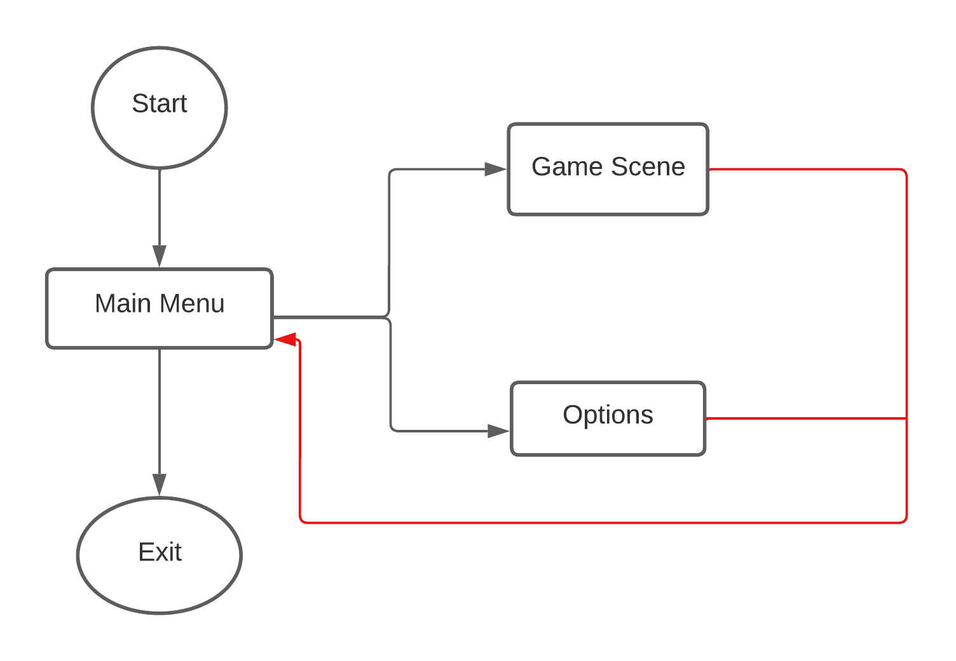
System Behavior
Scene Manager
The system behavior is handled by the user’s input. In this case the scene manager handles the transition from the main menu scene to the game scene where the user can start playing the game.
MainMenu Scene:
This is the start scene where the user is taken to when the game is loaded. The user is given a menu with buttons to select a few options to start the game, change settings for sound and exit the game.

Slide 6
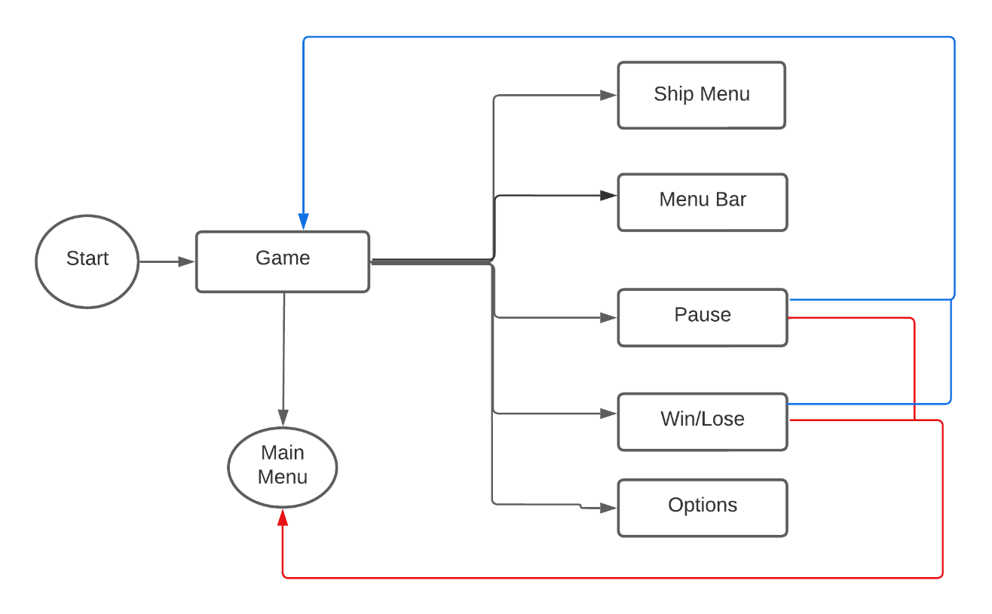
System Behavior
Scene Manager
The system behavior is handled by the user’s input. In this case the scene manager handles the transition from the main menu scene to the game scene where the user can start playing the game.
Game Scene:
Here the user is given a ship placing menu which has all the ships available. There are five buttons in it, which four are used for the selection of the ships and one to control the orientation of the ship to be placed. There is a top bar menu which is used to start the game and also keep track of player scores once the game begins.

Slide 7
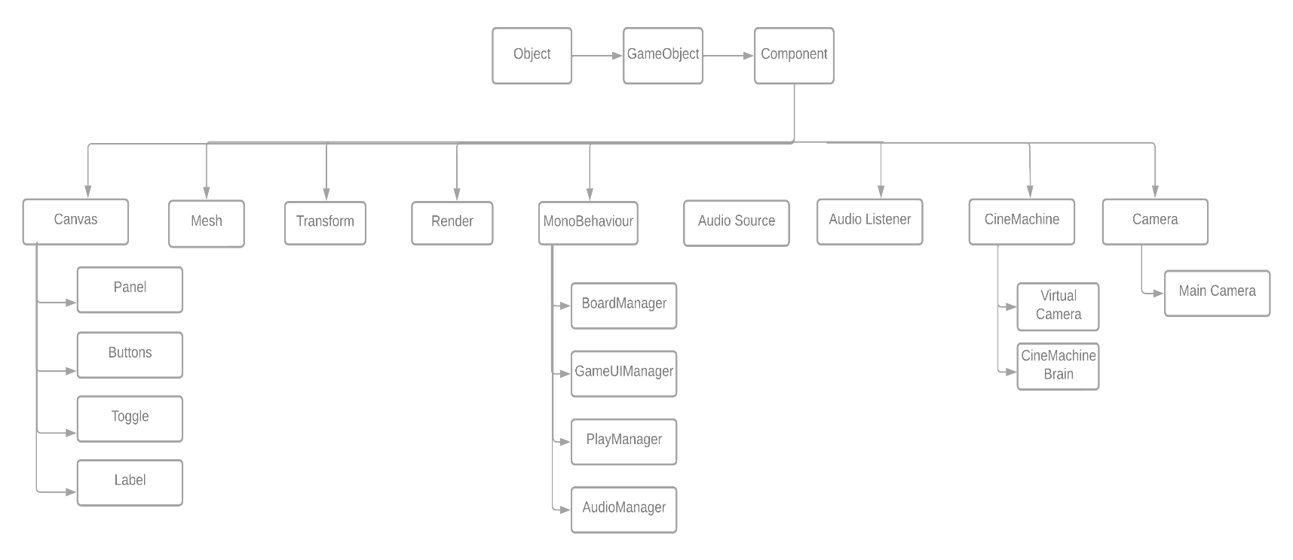
Unity Class hierarchy
The unity class hierarchy demonstrates the components used to create many of the prefabs and its related functions within Unity’s game engine. The creation of game objects sustain many of the components listed to provide a foundation for the game.
Notes:
The diagram on the right are the components that were use for the design of the game, and it also shows the main scripts under the monoBehaviour which were used for handling various task for the application.

Slide 8
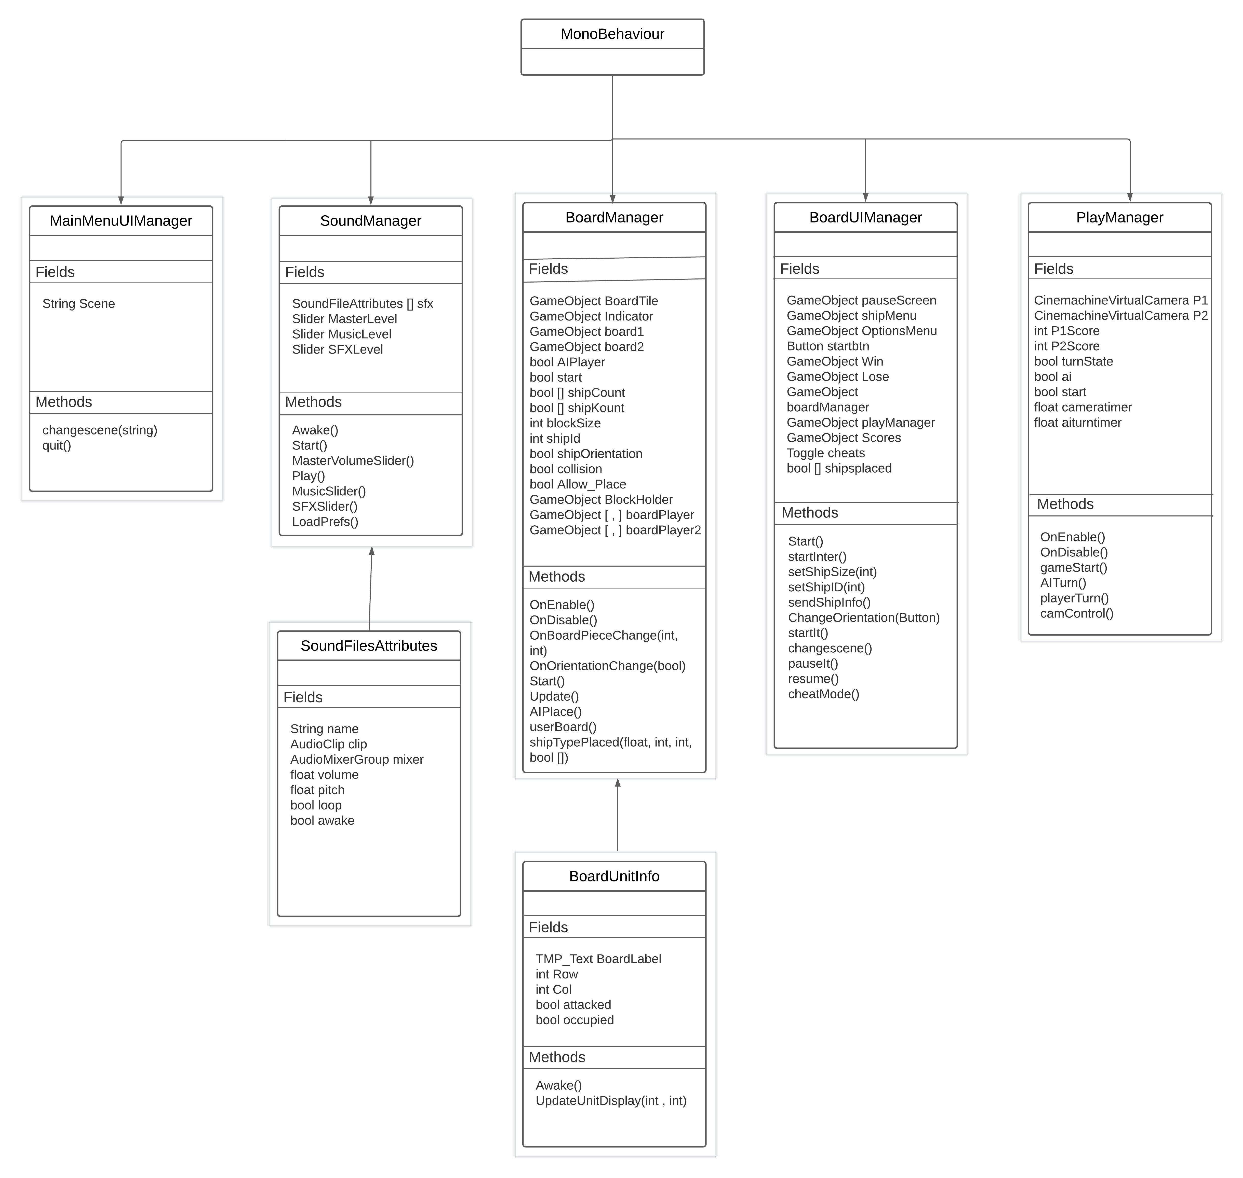
Detailed Class Design
The scripts with their methods, fields and helper scripts.
Notes:
For the detail design, here is break down of the scripts from the previous slide. As you can see there are four main scripts and two helper scripts that handle different functions for the game. A few of them help with the setting up the game and others handle user interface interactions between the user and the game interface. I will go more in detail on what each script does in the demo and code portion of the presentation.

Slide 9
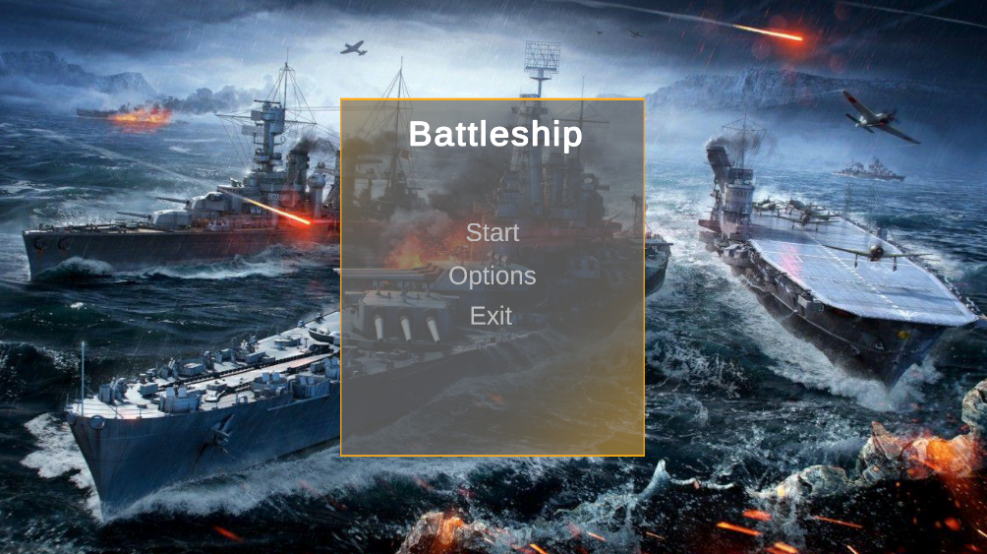
User Interface and Flow
A simple user interface designed for the menus within the game. Most of the menus have a golden border to it with a fading gold to grey effect as the textures reach the center of the menus. The buttons are a dark grey when the user isn’t hovering over them and become white and plays a sound once the user moves the cursor on top of it and another sound is played when the button is clicked. The menu titles are bolded and colored white to help remind the user what menu they are on.

Slide 10
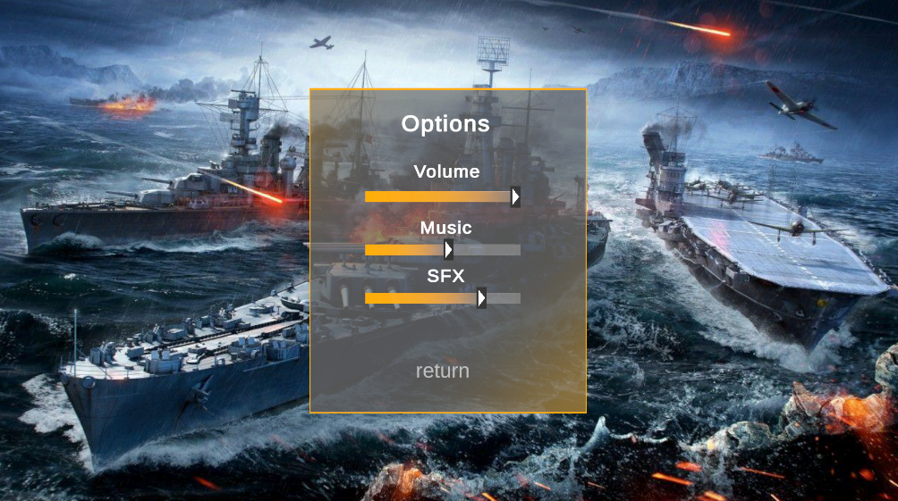
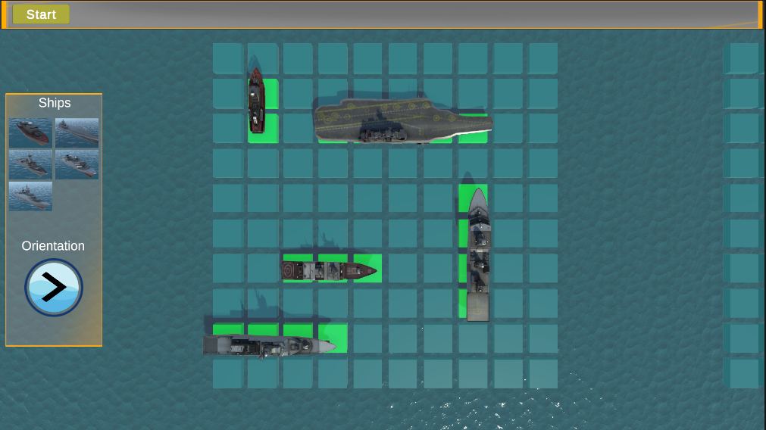
User Interface and Flow
The top image is of the options menu with sliders to adjust volume. While the bottom one is from the game scene in the game where all the ships were placed, and the user can begin to play the game once start button is clicked.
Notes:
The top image is of the options menu in the game. It is similar in design to the main menu on the previous slide, the only difference is the options menu has sliders to adjust the volume. While the bottom one is from the game scene in the game where all the ships were placed, and the user can begin to play the game once start button is clicked.

Slide 11
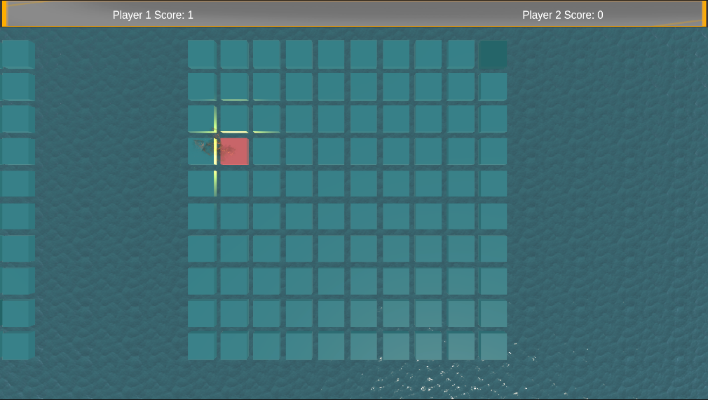
User Interface and Flow
Once the game has begun the player scores can be seen at the top and the other menus are set to inactive on the scene.
Notes:
Once the game has begun the player scores can be seeing at the top and the other menus are set to inactive on the scene. As you can see on the image the tiles have different colors. The red signifies that a hit has been register with an occupied tile and a small directional light is used along a smoke effect and sound will be played. The darker tile on the top right is for hits on tiles which are not occupied by a ship and a sound is also made for it.

Slide 12
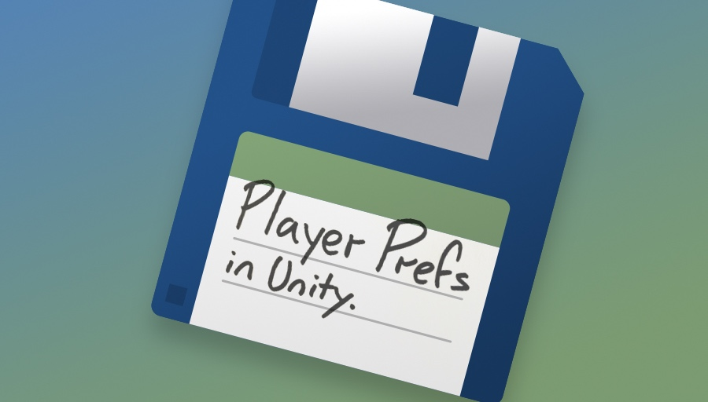
Design Approach
Most of the data for the user settings and player scores are stored through Unity’s PlayerPref class. Once the game is over the scores are cleared but the sound settings remain the same no matter the scene the player is on.

Slide 13
Challenges and Lessons
Challenges faced
Unity was easy to use but hard to master
C# was new language I used for this semester
Universal Render Pipeline and Visual Effects Graphs
Lessons Learned
Learn the basics of unity change objects attributes, assign scripts, instantiation.
Became more familiar with C# scripts
Notes:
Unity and C# are the new set of tools I worked with the most this semester. While they were easy to use both are difficult to master. For example, when I was moving my project to start using the Universal Render Pipeline, the ships, the menus, buttons, sliders lost their texture. I also had a blur shader which I was unable to replicate under URP. Then for visual effects it was difficult to use the built-in effect particles within unity and opted to try visual effects graph which felt more friendly to develop in. The lessons I learned was through the course and with the project were getting more familiar with the basics of Unity when it came to object attributes, particle effects, Instantiation and became a bit more familiar with C# which I never use till this semester.

Slide 14
Demo of Application
Notes:
Now I will go over the code first and then move on to do a demo for the game.

